Slide 1

A06 - Crash Severity Prediction Model
Megha Arul SenthilKumar, Neeharika Kamireddy, Rajashree Ramaprabu

Slide 2
Problem Statement
Develop a prediction model that
that detects the driver’s injury severity and,
the damage extent of the vehicle involved.
Potential to save lives, mitigate injuries, and optimize resources in the realm of road safety.
Provides valuable insights into dealing with different outcomes from road collisions.

Slide 3
Beneficiaries and Significance
Optimizing emergency response, resource allocation, and road safety initiatives.
Timely medical assistance
Improved planning, infrastructure development, and policy formulation to enhance overall road safety
Reduces frequency and severity of road accidents
Road Authorities to deploy emergency services more effectively.
Traffic control team to Implement targeted traffic management strategies.
Stakeholders, law enforcement agencies and policymakers, to implement targeted interventions.

Slide 4
Data and its Source
Table Name: Crash_Reporting_Drivers_Data
Rows: 168850
Columns: 43
Data Source: US Data Government
Provides information on motor vehicle traffic collisions.
Has columns such as Route Type, Collision type, Weather, Injury Severity, Vehicle Damage Extent.

Slide 5
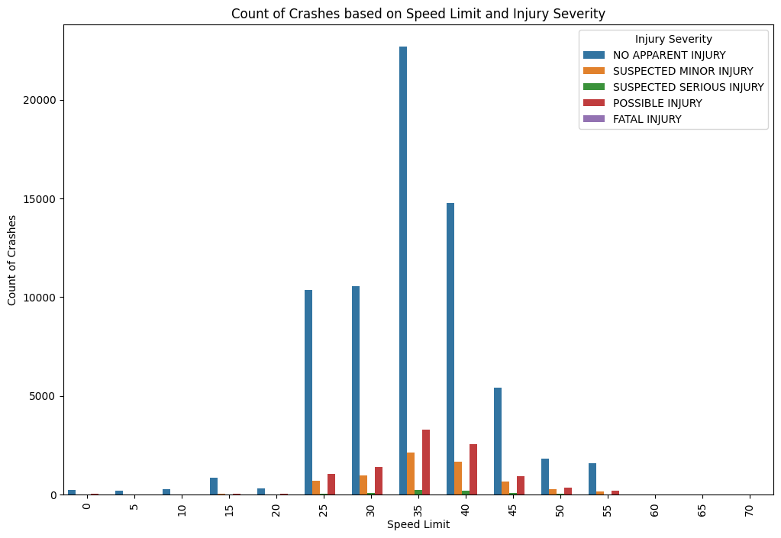
Descriptive Analysis
Distribution of crashes based on different speed limits and their corresponding injury severities.
Significant number of accidents have occurred when the speed limit was 35
Safety measures and policy decisions

Slide 6
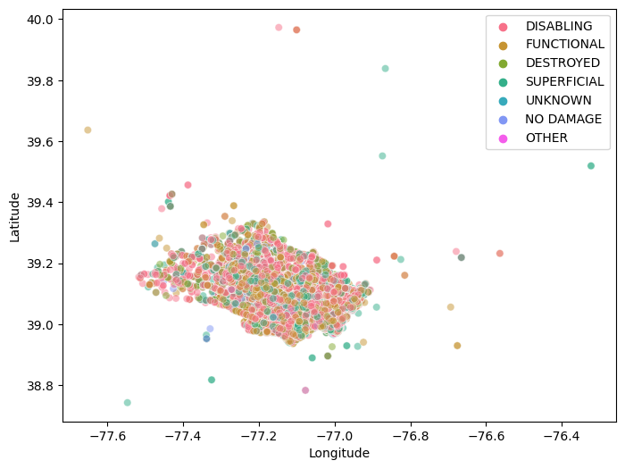
Descriptive Analysis
Insights into the correlation between the extent of vehicle damage and the geographic coordinates
Location based safety implementations suggestions

Slide 7
Models
Logistic Regression
Decision Tree
Random Forest
Support Vector Machine
Multinomial Naive Bayes
KNearest Neighbors

Slide 8
Approaches for Model
Injury Severity
Logistic Regression
Accuracy : 80%
Balanced Accuracy : 28%
Precision : 71%
Cross Validation Accuracy : 80%
Decision Tree
Accuracy : 99.6%
Balanced Accuracy : 99%
Precision : 99.6%
Cross Validation Accuracy : 68%
Random Forest
Accuracy : 99.65%
Balanced Accuracy : 99.2%
Precision : 99.65%
Cross Validation Accuracy : 80%
Vehicle Damage Extent
Logistic Regression
Accuracy : 54%
Balanced Accuracy : 35%
Precision : 52%
Cross Validation Accuracy : 53%
Decision Tree
Accuracy : 99%
Balanced Accuracy : 99%
Precision : 99%
Cross Validation Accuracy : 42%
Random Forest
Accuracy : 99.65%
Balanced Accuracy : 99.2%
Precision : 99.65%
Cross Validation Accuracy : 80%

Slide 9
Best Model Approach
Decision Tree
Used Decision Tree to train "Injury Severity" (y1) on the training set
Explored trees with decision trees of different max_depths
Get Important features
Get cost-complexity pruning path before and after feature selection
Used Random Search Cv to choose the total number of nodes and max depth
Used that to build a decision tree model on test data

Slide 10
Main Results
Injury Severity Accuracy from Decision Tree : 83.47%
Vehicle Damage Extent from Decision Tree : 53.45%

Slide 11
Challenges
Volume of dataset
Iterations
Overfitting
Troubleshooting

Slide 12
Conclusion
Identified top features for collisions
Speed Limit of 35, Crash location, Cross-Street Type of County etc.
Recommend to reduce the speed limit in high frequency crash locations
Identified Extent of Damage
Infrastructure planning and building recommendations
Identified Severity of Injury
Helps in allocating the emergency and medical resources in accident prone areas

Slide 13
Colab File Link
https://colab.research.google.com/drive/13OscFy7FsFjkcQw1KFyFBMN9bCbw-tcY?usp=sharing

